Slide 1
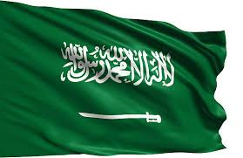
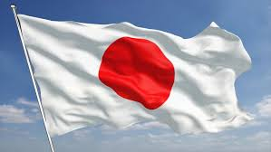
Education System bwetween Saudi Arabia and Japan

Slide 2
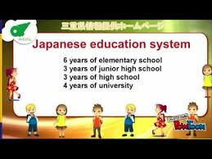
Similarities
Japan education..

Slide 3
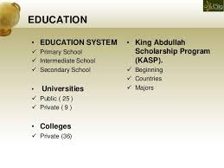
Similarities
Saudi Arabian education…

Slide 4
Similarities
Learners are required to attend schools for twelve years before entering university education in Saudi Arabia.

Slide 5
Similarities
Both countries offer an education system that has four years of university education for bachelor degrees, two years for masters, and three years for doctoral education

Slide 6
Similarities
Just like Saudi Arabia, japan higher education is provided in universities and colleges,

Slide 7
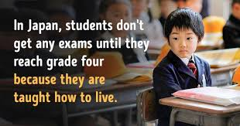
Differences in Japan…

Slide 8
Differences in Japan…
Japanese student goes for one month and one week every summer, two weeks during winter vacation and two weeks during spring vacation.

Slide 9
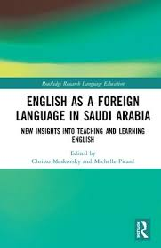
Differences in Arabia

Slide 10
Differences in Arabia…
In Saudi Arabia, schooling goes for five days, just like Japan, but the learners stay in school for eight hours per day.

Slide 11
References
http://baito2bwr.blogspot.com/2010/10/similarity-and-difference-between.html
http://baito2bwr.blogspot.com/2010/10/similarity-and-difference-between.html

